Slide 1


THESIS PRESENTATION
Global Economic Impact of COVID-19: Nigeria in Perspective
L. ABDULMUMIN
J.ALUKO
M.EGBO
L.EHIZOJIE
Masters in Data Science
2021/2022
Thesis Advisor Name
Adebayo Solomon

Slide 2
Thesis Presentation Outline
Title Slide
01
Introduction
03
Hypotheses
04
Literature Review
05
Research Methodology
06
Data Visualization & Result
07
Summary Conclusion & Recommendation
14
References
15

Slide 3
Introduction: Statement of Problem
It is estimated that during the lockdown periods, Nigeria’s GDP suffered a 34.1 percent loss due to COVID-19, amounting to USD 16 billion, with two-thirds of the losses coming from the services sector.
The economic impacts of COVID-19 include a 14-percentage point temporary increase in the poverty headcount rate for Nigeria, implying that 27 million additional people fell below the poverty line during lockdown.

Slide 4
Aims and Objectives
The Impact of covid-19 on Nigeria trade flows
The Impact of covid-19 on Nigerian supply chain and tourism
The impact of the pandemic on Nigeria healthcare system
Impacts of the pandemic on aviation sector in Nigeria

Slide 5

01
The covid-19 pandemic negatively impacted on the Nigerian economy
Hypothesis
02
The covid-19 pandemic positively impacted on the Nigerian economy
Brainstorming sections
Collection and gathering of related data Analysis/insights of the data
Visualization/interpretation of the data
Methodology

Slide 6
Literature Review
Global Economic Impact of Covid-19 – Nigeria in Perspective
01
Covid-19 Impact on Health Care
05
Disruption in Tourism Industry
02
06
Impact on Trade Flows
Covid-19 & Supply Chain
03
Inflation & Labour Shortage
07
Impact of Covid-19 on Sustainable Development Goals (SDGs)
04
Impact on the Nigerian Aviation Sector
08
The Uncertainties in the Nigerian Economy

Slide 7
Research Methodology
Description
&
Implementation
Study
Area
Data Analysis
This study is a retrospective analysis to review the economic impact of COVID-19 on Nigerian economy.
Data used was from (“Annual Gross Domestic Product at 33 Current Basic Prices”) obtained from a reputable source
This analysis covers Agriculture (Crop Production,etc),Industry (Manufacturing, Services (Information & communication, trades flows and inflation, supply chain and aviation, the tourism sector and the health sector.)
Nigeria, is a country in western Africa. Its land area is estimated to be 356,669 sq mi (923,768 sq km), with a population of about 217,376,000 (2022 est.).
a. Data Extraction
b. Data Transformation
c. Data Loading
d. Data Wrangling
e. Exploratory Data Analysis
f. Data Visualization and insights

Slide 8
Data Visualization & Results
Overview
The study uses both descriptive and inferential statistics to analyse and evaluate the results.
Descriptive Statistics have been used to know the structural properties of data.
Inferential analysis covers correlation and regression analysis.
Ordinary Least Square method is used for regression analysis to measure the strength and significance of relationship (Gul, 2012).
Lastly, the findings from the data were presented in a pictorial form.
03
In the face of the occurrence of the covid 19 pandemic, key sectors in the Nigerian economy recorded significant growth like Agriculture, Manufacturing industry, Telecoms and Health in terms of the absolute values…
but based on expected output dating back historically, most sectors had a negative percentage change with the Oil Refining being the worst hit at and closely followed by air transportation, Crude Petroleum and Natural Gas and Mining.
02
01

Slide 9
Data Visualization & Results

Slide 10
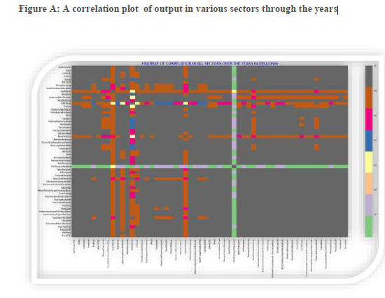
Data Visualization & Results
İn figure (figure A),
there is a strong negative correlation between rail transport & pipelines against other sectors, which may imply explicitly that the Rail transport & pipelines behave quite opposite to other sectors of the economy except for a slight positive correlation with Oil Refining .
There is a strong positive correlation between Oil Refining and Mining & Quarrying have a strong positive correlation between them over the years.
There seems to be a positive correlation amongst
other sectors with correlations tending toward 1 while there are many correlations at 1, it may not necessarily imply that an increase in any of such sector imply a positive output in another or vice versa.

Slide 11
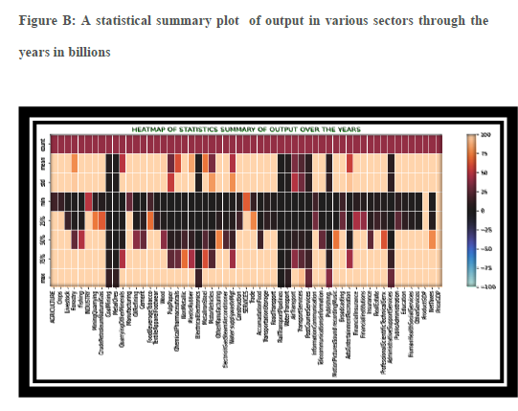
Data Visualization & Results
The figure(figure B) :
There’s the plots for Minimum, Mean, Standard Deviation, 25th, 50th and 75th percentiles of total outputs in various sectors in billions.
The mean and maximum statistics of total output in most sectors are seen to be grossing above 50billion except for Coal Mining, Metal Ores, Electrical Electronics, Rail Transport & Pipelines, Post & Courier Services, Publishing, And Administration Support Services
A closer look will also show that Manufacturing, Food Beverage & Tobacco, İndustry, Services, İnformation & Telecommunications showed a positive statistical summary over the years making them the most thriving sector of the economy irrespective of challenges or outcomes in political, economic or natural stability or disaster.

Slide 12
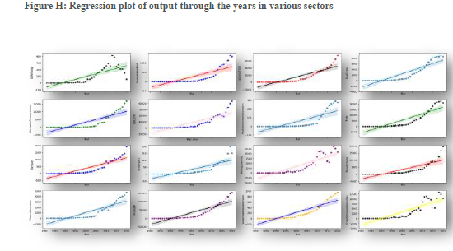
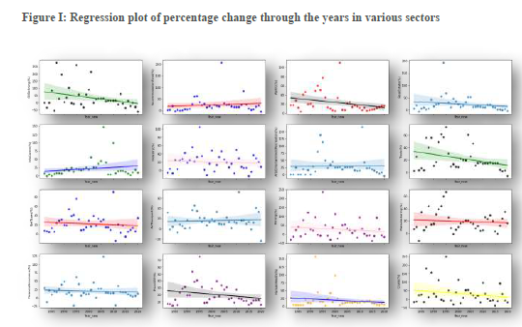
Data Visualization & Results
(Figure I) is a replica of plot (Figure H) but both differ in that they are absolute value regression and percentage change regression respectively.
As can be seen above in (figure H), the regression plot of absolute output values in all of the economic sectors have a positive correlation with time which may lead one to say that over time, the economic sectors have been thriving better but a closer look at (figure I), which is a regression of percentage of change over the years will show clearly that most sectors of have rather a negative correlation with time.

Slide 13
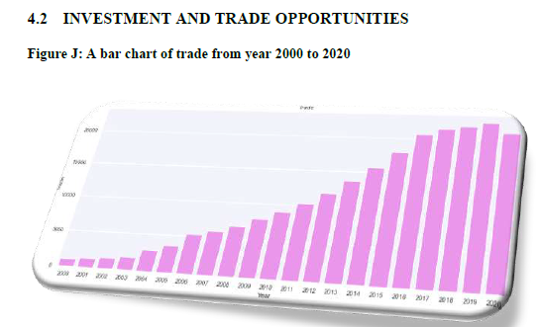
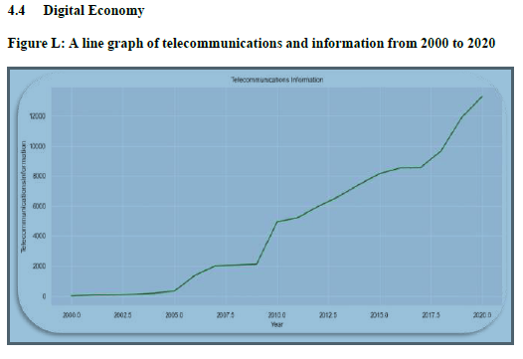
Data Visualization & Results
Due to the effects of the pandemic and in an effort to stop its spread, Nigeria's trade and business partners, who are mostly in Europe, the United States, and China, closed their economies and international borders.
This has a significant impact on Nigeria's overall economy, reserve, and national revenue earnings.
Figure 4.4 demonstrates a rise in the percentage of people who use the internet to
make mobile calls, pay bills, and send virtual currency.
However, very few universities or schools provided an entire academic program online during the COVID-19 pandemic. Instead of adopting the "working from home model," many businesses operated under the tradition of going into the office and doing your work.
13

Slide 14
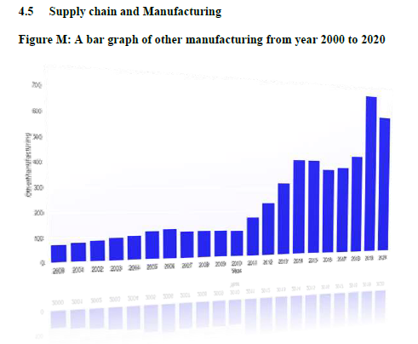
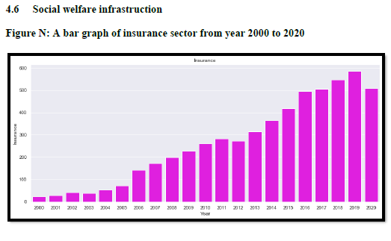
Data Visualization & Results
Figure 4.5 shows the economic trends in manufacturing industries measured by the
Purchasing Managers Index (PMI). Prior to the Covid-19 pandemic's onset.
The manufacturing industries can be seen to be on the rise in the image. The border closure and restrictions on travel during the outbreak in 2020 indicated a drop in exports and manufacturing industry activity.
This was due to the lockdown restriction, which stopped workers from working, lenders from issuing new loans, and customers from purchasing things at the time, all of which impacted the real sector, particularly supply chains
Figure 4.6 shows the analysis of Nigeria’s social welfare infrastructure prior to the COVID-19 pandemic. It demonstrates that from 2012 to 2019, the social insurance programs' sufficiency as a share of recipient households' overall wellbeing in Nigeria rose.
A social safety net existed in Nigeria prior to the COVID-19 pandemic, as seen by the increase. However, in practice, these protections were nonexistent and ineffective during the COVID-19 pandemic in 2020.
14

Slide 15
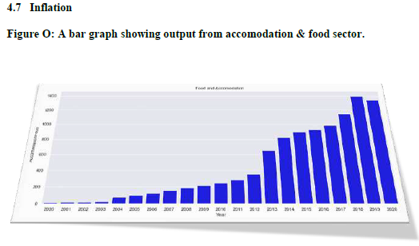
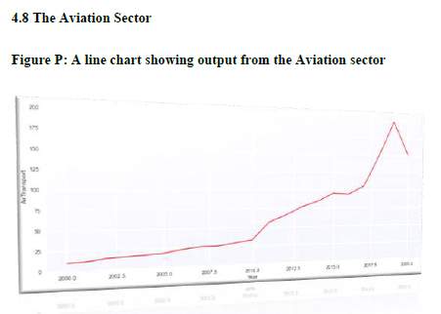
Data Visualization & Results
Figure 4.7 shows an upward trend prior to the outbreak up until 2020 when lockdown was enforced by the Nigeria government to curtail the spread of Covid-19.
Nigeria, which has the highest amount of extremely poor people in the world according to the United Nations statistical report, was significantly affected by the COVID pandemic. More specifically, as inflation, unemployment, and poverty rates grew, the COVID pandemic had a significant negative impact on Nigeria's level of poverty and economic suffering.
Figure 4.7 shows an upward trend prior to the outbreak up until 2020 when lockdown was enforced by the Nigeria government to curtail the spread of Covid-19.
Nigeria, which has the highest amount of extremely poor people in the world according to the United Nations statistical report, was significantly affected by the COVID pandemic. More specifically, as inflation, unemployment, and poverty rates grew, the COVID pandemic had a significant negative impact on Nigeria's level of poverty and economic suffering.
15

Slide 16
Summary/Conclusion & Recommendation
Summary
The Covid-19 pandemic epidemic had a big influence on the supply chain
The sharp decline in economic activity has had a substantial influence on social policy as well a the social and economic well-being of residents.
The findings revealed a significant decline in global demand for commodity which affected the price of crude oil in the global market.
These COVID-19 pandemic spillovers caused a decrease in commodity demand and restricted economic activity when the physical distance rules were put into place
Hence, the study accepted the hypothesis that the covid-19 pandemic negatively impacted on the Nigerian economy.
16

Slide 17
Summary/Conclusion & Recommendation
Conclusion
Based on the evidence at hand, this study comes to the conclusion that the COVID-19-induced lockdown has severely restricted economic activity and, consequently, the cyclical movement of revenue in Nigeria
Recommendation.
To diversify the economy and lessen Nigeria's reliance on revenue from crude oil exports, policymakers should enact economic reforms.
Strengthen Nigeria's national health system's resistance to the spread of contagious illnesses.
Policymakers should also use legislation to establish a strong social safety net for all residents, especially for unemployed people and low-income households.
Government has to concentrate on reestablishing institutions and give organizations like NCDC and NAFDAC more attention

Slide 18

This Photo by Unknown Author is licensed under CC BY-NC-ND

Slide 19
References
01
The raw code of this work can be assessed on GitHub through https://github.com/ibeabu-
chi/python_EDA/blob/master/capstone%20analysis.ipynb
02
Impacts of COVID-19 on inclusive economic growth in middle-income countries
K4D Helpdesk Report 811. Institute of Development Studies, Brighton, UK (2020)
Google Scholar
03
Gul Amin: Development and evaluation of ordinary least squares , 2012

